Slide 1
Basic Concept of Microprocessor
Differences between :
Microcomputer : A computer with a Microprocessor as its CPU. Includes memory,I/O,etc.
Microprocessor : silicon chip which includes ALU, register circuits and control circuits.
Microcontroller : silicon chip which includes Microprocessor, memory and I/O in a single package.

Slide 2
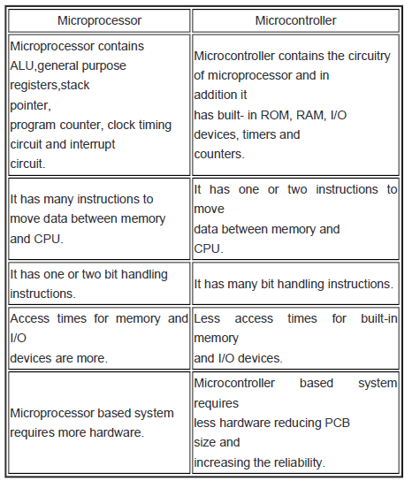
Difference between Microprocessor and Microcontroller

Slide 3
What is a Microprocessor
The word comes from the combination of micro and processor.
Processor means a device that processes whatever. In this context processor means a device that processes numbers, specifically binary numbers 0’s and 1’s.
Micro means all of the components that are made are placed in a single silicon chip. The size became several thousands time smaller and the speed became several hundred times faster. Thus the name micro

Slide 4
Definition of Microprocessor
The Microprocessor is a programmable device that takes in numbers, performs on them arithmetic or logical operations according to the program stored in memory and then produces other numbers as a result.

Slide 5
A Microprocessor based system
Input
Microprocessor
Output
Memory

Slide 6
History of Microprocessor
Fairchild Semiconductors (founded in 1957) invented the first IC in 1959.
In 1968, Robert Noyce, Gordan Moore, Andrew Grove resigned from Fairchild Semiconductors.
They founded their own company Intel (Integrated Electronics).
Intel grown from 3 man start-up in 1968 to industrial giant by 1981.
It had 20,000 employees and $188 million revenue.

Slide 7
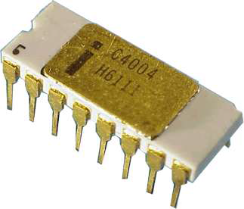
4004
First microprocessor (1971)
Characteristics
10 mm process
2300 transistors
400 – 800 kHz
4-bit word size
16-pin DIP package
- It could execute around
60,000 instructions per
second.

Slide 8
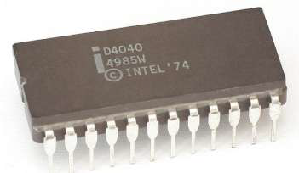
4040
Introduced in 1974.
It was also 4-bit μP

Slide 9
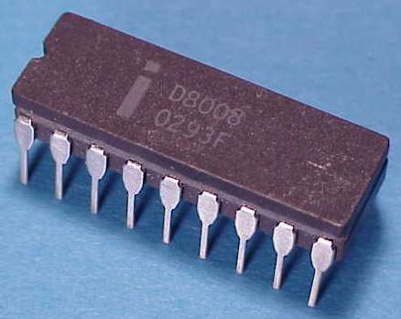
8008
8-bit follow-on (1972)
Characteristics
10 mm process
3500 transistors
500 – 800 kHz
8-bit word size
18-pin DIP package
Could execute 50,000
instructions per second.
Note 8-bit datapaths
Individual transistors visible

Slide 10
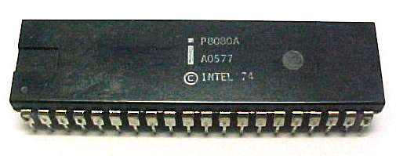
8080
16-bit address bus (1974)
Used in Altair computer
Characteristics
6 mm process
6000 transistors
2 MHz
8-bit word size
40-pin DIP package
- Was 10 times faster than 8008.
- Could execute 5,00,000 instructions per second.

Slide 11
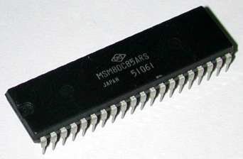
8085
Introduced in 1976.
It was also 8-bit μP.
Its clock speed was 3 MHz.
Its data bus is 8-bit and
address bus is 16-bit.
It had 6,500 transistors.
Could execute 7,69,230 instructions per second.
It could access 64 KB of memory.
It had 246 instructions.
Over 100 million copies were sold.

Slide 12
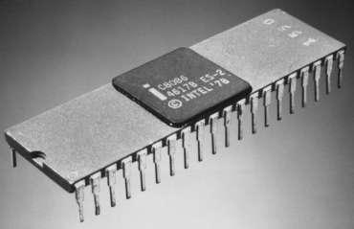
8086
16-bit processor (1978-9)
IBM PC and PC XT
Revolutionary products
Characteristics
3 mm process
29k transistors
5-10 MHz
16-bit word size
40-pin DIP package
Its data bus is 16-bit and address bus is 20-bit.
It could access 1 MB of memory.
It had 22,000 instructions.
It had Multiply and Divide instructions.

Slide 13
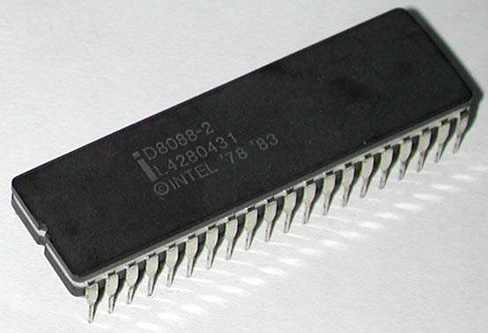
8088
Introduced in 1979.
It was also 16-bit μP.
It was created as a cheaper
version of Intel’s 8086.
It was a 16-bit processor with
an 8-bit external bus.
Could execute 2.5 million instructions per second.
This chip became the most popular in the computer
industry when IBM used it for its first PC.

Slide 14
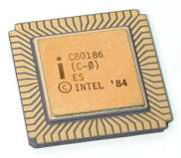
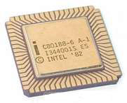
80186/80188
Introduced in 1982.
They were 16-bit μPs.
Clock speed was 6 MHz.
80188 was a cheaper version of 80186 with an 8-bit external data bus.
They had additional components like:
Interrupt Controller
Clock Generator
Local Bus Controller
Counters

Slide 15
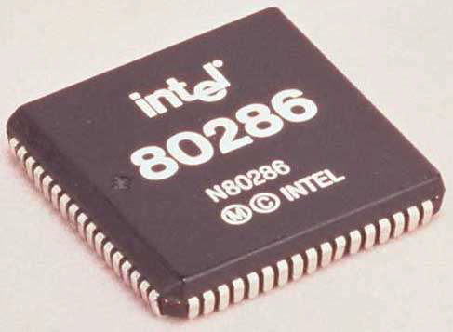
80286
Virtual memory (1982)
IBM PC AT
Characteristics
1.5 mm process
134k transistors
6-12 MHz
16-bit word size
68-pin PGA
It could address 16 MB of memory.
It had 1,34,000 transistors.
It could execute 4 million instructions per second.
Regular datapaths and ROMs

Slide 16
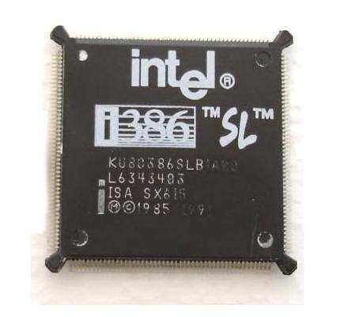
80386
32-bit processor (1985)
Modern x86 ISA
Characteristics
1.5-1 mm process
275k transistors
16-33 MHz
32-bit word size
100-pin PGA
➢ Different versions:
80386 DX
80386 SX
80386 SL
Intel 80386 became the best selling microprocessor in history.
32-bit datapath, microcode ROM, synthesized control

Slide 17
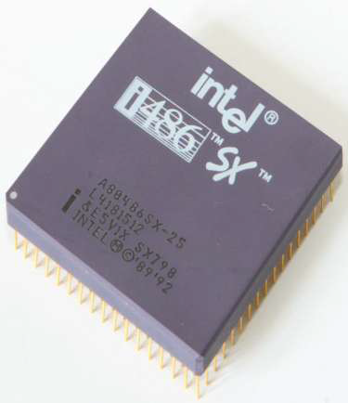
80486
Pipelining (1989)
Floating point unit
8 KB cache
Characteristics
1-0.6 mm process
1.2M transistors
25-100 MHz
32-bit word size
168-pin PGA
It had five different versions:
80486 DX, 80486 SX, 80486 DX2, 80486 SL, 80486 DX4
8 KB of cache memory was introduced.
Cache, Integer datapath,FPU, microcode, synthesized control

Slide 18
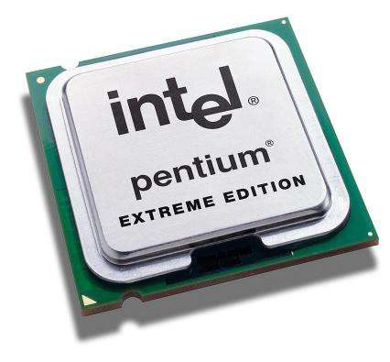
Pentium
Superscalar (1993)
2 instructions per cycle
Characteristics
0.8-0.35 mm process
3.2M transistors
60-300 MHz
32-bit word size
296-pin PGA
It was originally named 80586
Could execute 110 million instructions per second.
It could address 4 GB of memory.
Cache memory:
8 KB for instructions. And 8 KB for data.

Slide 19
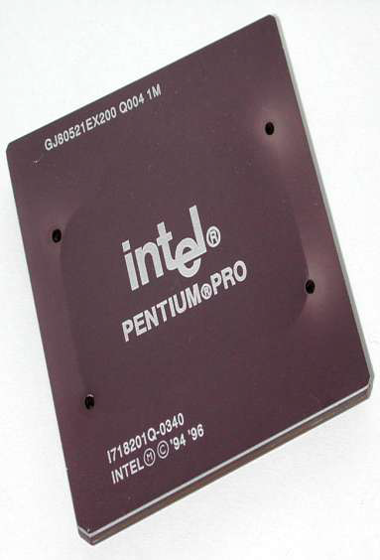
Pentium Pro
Dynamic execution (1995-99)
3 micro-ops / cycle
Multimedia instructions
Characteristics
0.6-0.18 mm process
166-1000 MHz
32-bit word size
Introduced in 1995.
It was also 32-bit μP.
It had L2 cache of 256 KB.
It had 21 million transistors.
It was primarily used in server systems.
Cache memory: 8 KB for instructions and 8 KB for data.

Slide 20
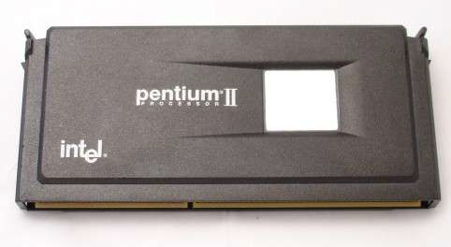
Pentium II
Introduced in 1997.
It was also 32-bit μP.
Its clock speed was 233 MHz to 500 MHz.
Could execute 333 million instructions per second.
L2 cache & processor were on one circuit.

Slide 21
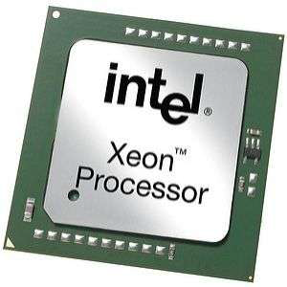
Pentium II Xeon
Introduced in 1998.
It was also 32-bit μP.
It was designed for servers.
Its clock speed was 400
MHz to 450 MHz.
L1 cache of 32 KB & L2
cache of 512 KB, 1MB or 2 MB.
It could work with 4 Xeons in same system.

Slide 22
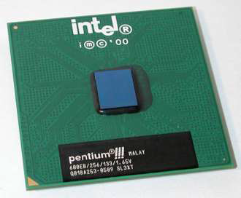
Pentium III
Introduced in 1999.
It was also 32-bit μP.
Its clock speed varied from 500 MHz to 1.4 GHz.
It had 9.5 million transistors.

Slide 23
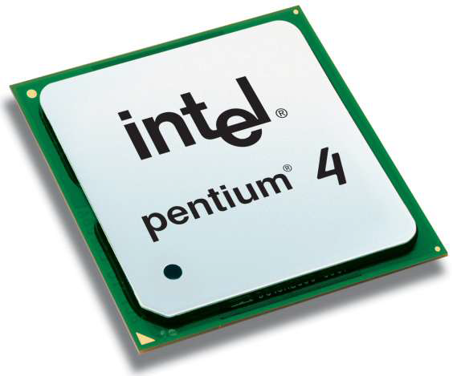
Pentium 4
Deep pipeline
Very fast clock
Characteristics
180 – 90 nm process
42-125M transistors
1.3-3.8 GHz
32-bit word size
478-pin
Introduced in 2000.
L1 cache was of 32 KB & L2 cache of 256 KB.
All internal connections were made from aluminium to copper.

Slide 24
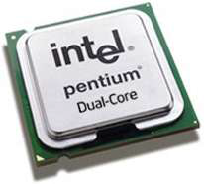
INTEL Dual Core
Introduced in 2006.
It is 32-bit or 64-bit μP.
It has two cores.
Both the cores have there own internal bus and L1
cache, but share the external bus and L2 cache
It supported Simultaneously Multi-Threading technology.
E.g.: Adobe Photoshop supported SMT.

Slide 25
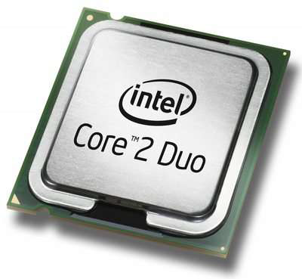
INTEL Core 2
Introduced in 2006.
It is a 64-bit μP.
Its clock speed is from 1.2 GHz to 3 GHz.
It has 291 million transistors.
It has 64 KB of L1 cache per
core and 4 MB of L2 cache.
It is launched in three different
versions:
Intel Core 2 Duo
Intel Core 2 Quad
Intel Core 2 Extreme

Slide 26
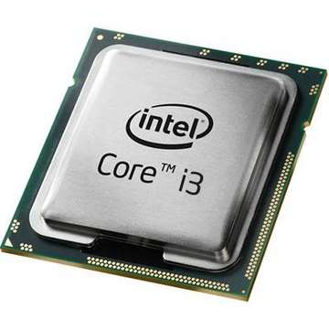
INTEL Core i3
Introduced in Jan. 2010.
32nm process technology
It is a 64-bit μP.
It has 2 physical cores.
Its clock speed is from 2.93
GHz to 3.33 GHz.
It has 781 million transistors.
It has 64 KB of L1 cache
512 KB of L2 cache and 4 MB of L3 cache.

Slide 27
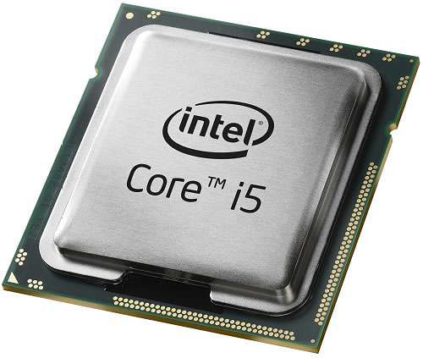
INTEL Core i5
Introduced in Sept. 2009.
45nm process technology
It is a 64-bit μP.
It has 4 physical cores.
Its clock speed is from 2.40
GHz to 3.33 GHz.
It has 781 million transistors.
It has 64 KB of L1 cache per core, 256 KB of L2
cache and 8 MB of L3 cache.

Slide 28
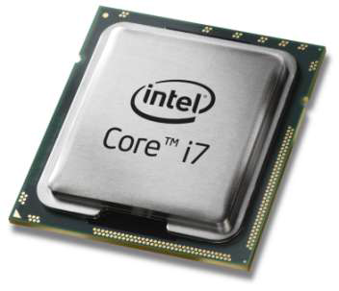
INTEL Core i7
Introduced in Nov. 2008.
45nm process technology.
It is a 64-bit μP.
It has 4 physical cores.
Its clock speed is from 2.66
GHz to 3.6 GHz.
It has 781 million transistors.
It has 64 KB of L1 cache per core, 256 KB of L2 cache and 8 MB of L3 cache.

